Slide 1
Welcome to Thermo!
Let’s check out the syllabus on Canvas, especially
Resources you’ll need
Rhythm of the week
What CGIs are
Contingencies for missing class
Evaluation
Topic schedule

Slide 2
Thermodynamics and molecular insight
A lot of Thermo is about making this connection:
Macroscopic world
Microscopic world
→ Use macroscopic experience (measurements of T, P, V, etc.) to figure out how molecules behave
Use what we think we know about how molecules behave to make predictions about or explain our macroscopic experience

Slide 3
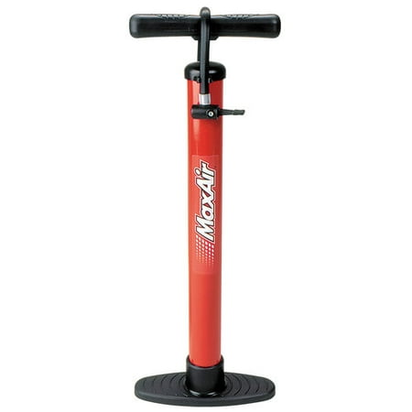
Using what we know about how molecules behave to explain the macroscopic world
Macroscopic experience:
If you compress a gas, it tends to heat up
Room Temperature

Slide 4
Using what we know about how molecules behave to explain the macroscopic world
Macroscopic experience:
If you compress a gas, it tends to heat up
Warmer

Slide 5
Using what we know about how molecules behave to explain the macroscopic world
Macroscopic experience:
If you compress a gas, it tends to heat up
Warmer still

Slide 6
Using what we know about how molecules behave to explain the macroscopic world
Macroscopic experience:
If you let a gas expand, it tends to cool down and draw heat from the surroundings
Colder

Slide 7
Using what we know about how molecules behave to explain the macroscopic world
Macroscopic experience:
If you let a gas expand, it tends to cool down and draw heat from the surroundings
Colder still

Slide 8
Using what we know about how molecules behave to explain the macroscopic world
Macroscopic experience:
This is called adiabatic heating/cooling
Colder still

Slide 9
To explain adiabatic heating/cooling, we’ll need some kind of molecular model …
The kinetic-molecular theory of gases
molecules are in constant motion
Slower-moving molecules=> lower temperature
Faster-moving molecules => higher temperature
https://miro.medium.com/v2/resize:fit:668/1*avcGLryPlvBJQ6lABc_4dg.gif

Slide 10
The kinetic-molecular theory also says molecular speeds will change after hitting a moving wall
Normally, when a molecule hits a wall, it bounces back with the same speed.

Slide 11
The kinetic-molecular theory’s explanation of adiabatic heating/cooling
When the molecule hits an advancing wall (because the container is shrinking), the molecule bounces back faster; and we just said that faster-moving molecules correspond to higher temperature.

Slide 12
The kinetic-molecular theory’s explanation of adiabatic heating/cooling
When the molecule hits a receding wall (because the container is expanding), the molecule bounces back more slowly; and we just said that slower-moving molecules correspond to lower temperature.

Slide 13
What we just did
Macroscopic world
Microscopic world
→ Use macroscopic experience (measurements of T, P, V, etc.) to figure out how molecules behave
Used what we think we know about how molecules behave to make predictions about or explain our macroscopic experience
To a thermodynamicist, making quantitative predictions is a form of explanation.

Slide 14
To make predictions quantitative, a key concept is the idea of a Thermodynamic Surface
What we’re showing here is a thermodynamic surface, also known as a state function. Its name here is F, but it could be P, U, H, S, or G.
The (x,y) space below is called the state space. Could be lots of different combinations, but typically it’ll be (T,V) or (T,P).
Obviously, there’s a particular value of F for each combination of x & y, so we say F = F(x,y)
State function F
y
“State Space”
x

Slide 15
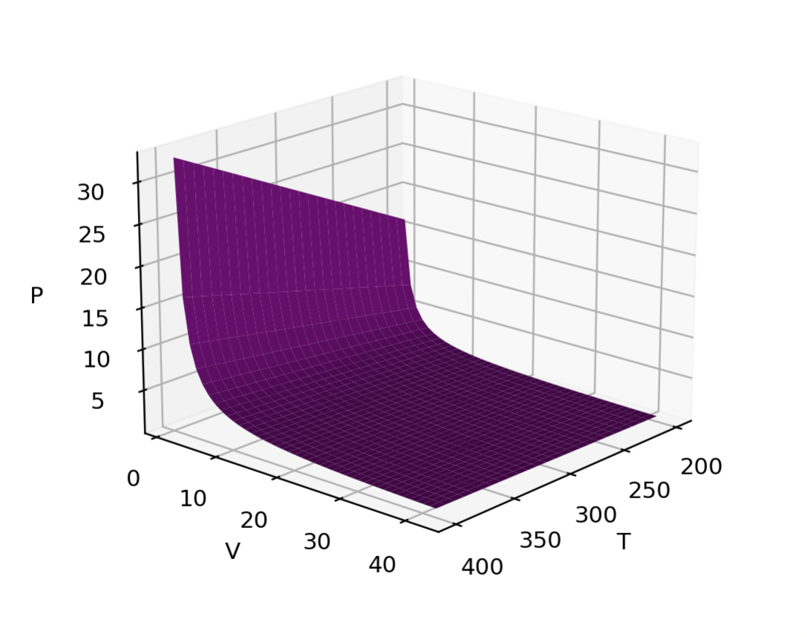
This thermodynamic surface tells us the pressure of a gas in a T,V state space
Here, the state function is the pressure of a gas.
The state space consists of the gas’s temperature and volume.
Each combination of temperature and volume implies a particular value of the pressure:
P(T,V)
This one is an ideal gas, actually. So we can say
P(T,V)=nRT/V

Slide 16
Isotherms are slices through a thermodynamic surface at a fixed temperature
This marks a constant-temperature slice (“isotherm”) through P(T,V). In this case, the isotherm temperature is 350 K.

Slide 17
Isotherms are slices through a thermodynamic surface at a fixed temperature
This marks a constant-temperature slice (“isotherm”) through P(T,V). In this case, the isotherm temperature is 350 K.
This isotherm is colder, at 300 K.

Slide 18
Isotherms are slices through a thermodynamic surface at a fixed temperature
This marks a constant-temperature slice (“isotherm”) through P(T,V). In this case, the isotherm temperature is 350 K.
This isotherm is colder, at 300 K.
The word isotherm applies to any thermodynamic function, but when we’re talking P(T,V), the isotherms are called Boyle isotherms. So here is a hot Boyle isotherm and a cold Boyle isotherm.

Slide 19
There are also isochores (fixed volume)
Here’s an isochore of P(T,V) at a fixed volume of 10 Liters

Slide 20
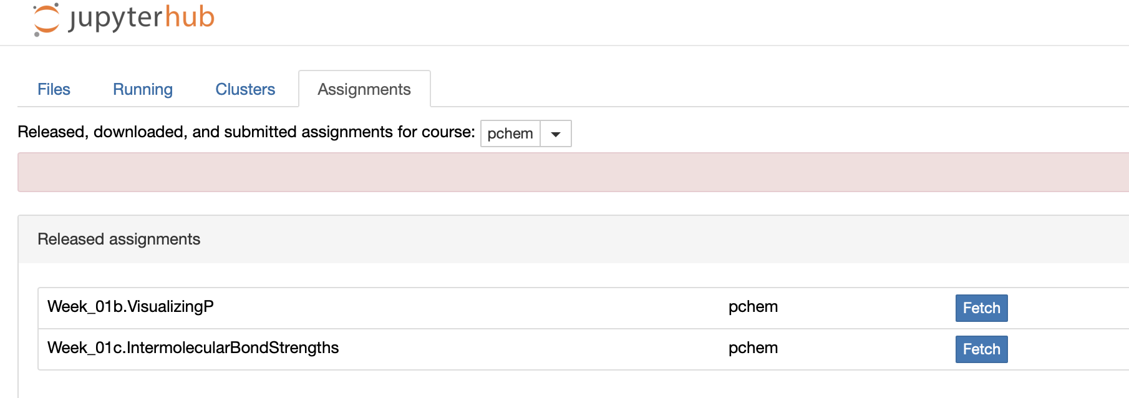
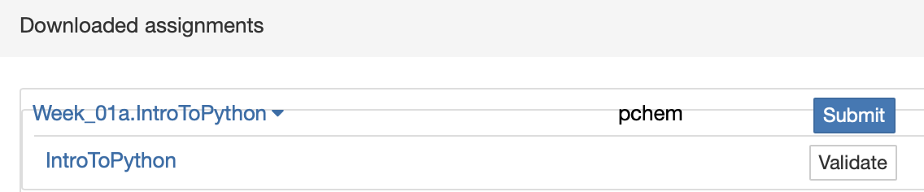
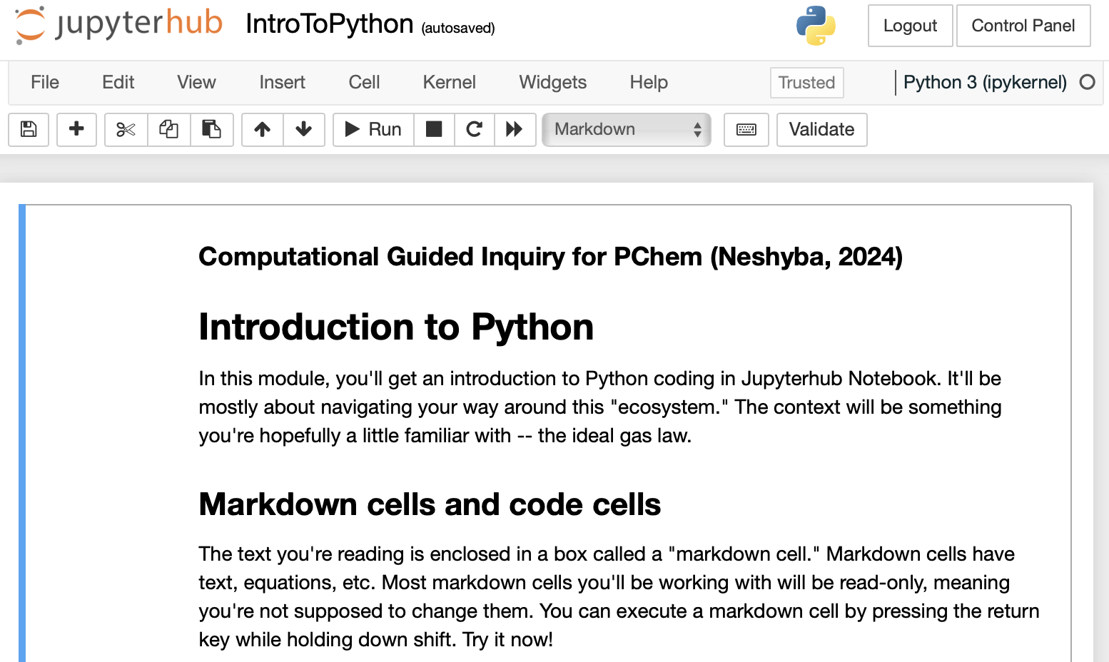
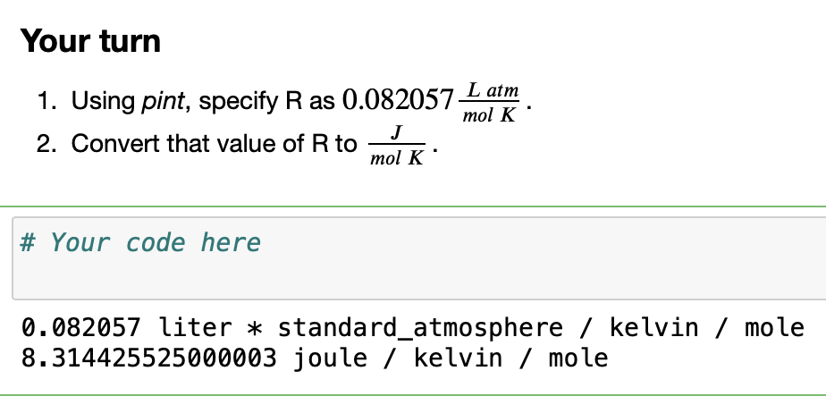
OK, Let’s get started with a little Python
Submit this (and all Week 1 CGIs) by midnight Saturday if you want feedback or get stuck. Final due date is one week after that (also midnight Saturday).

